Slide 1
LECTURE -6 (a)
Hypothesis Testing
Course Instructor
Engr. Naina Said

Slide 2
If I say its cloudy outside, how would you prove me right/wrong?
My claim : It is cloudy
What will you look for : Is it sunny?
If it is sunny, obviously my claim is wrong, and we can reject it.
If you are not able to prove that its sunny, then you have to accept my claim that it is cloudy.

Slide 3


Slide 4
What is a Hypothesis?
CSE-422: Data Analytics
In statistics, a hypothesis is a conclusion about population parameter which may or may not be true.
Example
The average age of a university student is 22.

Slide 5
NULL Hypothesis
CSE-422: Data Analytics
A null hypothesis is a hypothesis that says there is no difference between a parameter and a specific value or that there is no difference between two parameters
Example
In the previous slide, we made a hypothesis that the average age of a university student is 22 years.
Null Hypothesis : H₀ = there is no difference between hypothesis and the actual population mean
H₀ = μ=22 years
Null hypothesis always contains the equality!

Slide 6
Alternative Hypothesis
CSE-422: Data Analytics
Alterative hypothesis says that there is a difference between a parameter and a specific value or that there is a difference between two parameters
Example
Alternate hypothesis : H₁ = The average age of university students is not equal
to 22.
H₁ = μ ≠ 22
Alternative hypothesis never contains the equality!

Slide 7
What is Hypothesis Testing
CSE-422: Data Analytics
Hypothesis testing is an act in statistics whereby an analyst tests an assumption regarding a population parameter
Once we have made a claim/assumption (in the form of hypothesis), we will do some tests to check the validity of our claim.
The purpose of hypothesis testing is to determine whether there is enough
statistical evidence in favor of a certain belief, or hypothesis, about a parameter.

Slide 8
What is Hypothesis Testing (2)
CSE-422: Data Analytics
Since the null and alternative hypotheses are contradictory, you must examine evidence to decide if you have enough evidence to reject the null hypothesis or not.
The evidence is in the form of sample data.
After you have determined which hypothesis the sample supports, you make a
decision.
There are two options for a decision
Reject the null hypothesis.
Fail to reject the null hypothesis.

Slide 9

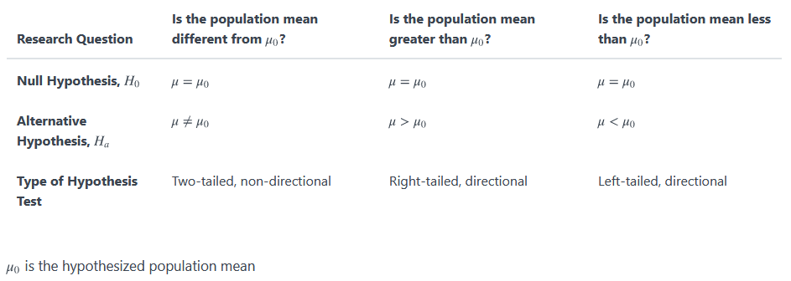
Hypothesis Tests for One Group Mean
CSE-422: Data Analytics

Slide 10
Important Note
CSE-422: Data Analytics
H₀ always has a symbol with an equal in it. H_{a} never has a symbol with an equal in it.
However, be aware that many researchers use = in the null hypothesis, even
with > or < as the symbol in the alternative hypothesis as an acceptable practice.

Slide 11
Example 1
CSE-422: Data Analytics
Research question: Is the average monthly rent of a one-bedroom apartment in State College, Pennsylvania less than $900?
What type of problem is this? Which test will be used? What is the null and
alternative hypothesis?
In this question we are comparing the mean of all State College one-bedroom apartments (i.e. μ ) to the value of $900. This is a single sample mean test. We want to know if the population mean is less than $900, so this is a left-tailed test. Our hypotheses are
H₀ : μ = 900 H₁ : μ <900

Slide 12
Example 2
CSE-422: Data Analytics
Research question: Is the average IQ score of all World Campus STAT 200 students higher than the national average of 100?
What type of problem is this? Which test will be used? What is the null and
alternative hypothesis?
In this question we are comparing the mean of all World Campus STAT 200 students (i.e. μ ) to the given value of 100. This is a single sample mean test. We want to know if the population mean is greater than 100, so this is a right-tailed test. Our hypotheses are:
H₀ : μ = 100 H₁ : μ >100

Slide 13
Critical Value
CSE-422: Data Analytics
Critical Value is the cut off value between Acceptance Zone and Rejection Zone.
We compare our sample evidence to the critical value and see whether it lies in the acceptance zone or rejection zone.
Critical value is decided based on level of significance.

Slide 14
Level of Significance
CSE-422: Data Analytics
Commonly used level of significance are 0.10, 0.05 and 0.01
α = 0.10 -> there is 10% chance that we will commit type 1 error.
α = 0.05 -> there is 5% chance that we will commit type 1 error.
α = 0.01-> there is 1% percent chance that we will commit type 1 error.

Slide 15
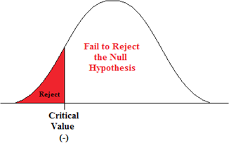
Critical Value for Left Tailed Test
CSE-422: Data Analytics
If the test is left tailed, the critical region, with an area equal to α will be on the left side of the mean.

Slide 16
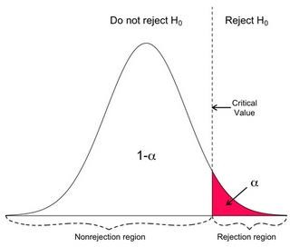
Critical Value for Right Tailed Test
CSE-422: Data Analytics
If the test is right tailed, the critical region, with an area equal to α will be on the right side of the mean.

Slide 17
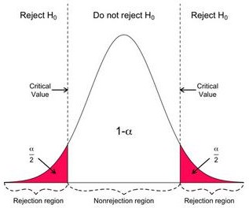
Critical Value for Two Tailed Test
CSE-422: Data Analytics
If the test is two tailed/non directional, α must be divided by 2. One half of the area will be to the right of the mean and one half will be to the left of the mean.

Slide 18
Hypothesis Testing
CSE-422: Data Analytics
Once claim is made by the researcher, he selects the correct statististical test with appropriate level of significance to see whether to accept or fail to reject the null hypothesis.
The statistical test uses the data from a sample to make a decision about whether to accept or fail to reject the null hypothesis.
The numerical value obtained from the statistical test is called “test value”
There are several statistical tests that we can use for hypothesis testing.
Z test
T test
ANOVA test
Chi Square test

Slide 19
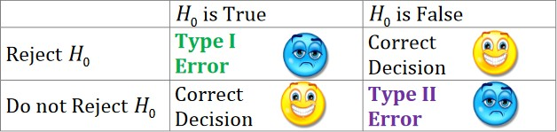
Type 1 and Type 2 Error
CSE-422: Data Analytics
When we make a conclusion from a statistical test there are two types of errors
that we could make. They are called type 1 and type 2 errors.

Slide 20
Example
CSE-422: Data Analytics
A man goes to trial where he is being tried for the murder of his wife.
We can put it in a hypothesis testing framework. The hypotheses being tested are
H₀ : Not Guilty
H₁ : Guilty
Type I error is committed if we reject H₀ when it is true. In other words, did not kill
his wife but was found guilty and is punished for a crime he did not really commit.
Type II error is committed if we fail to reject H₀ when it is false. In other words, if
the man did kill his wife but was found not guilty and was not punished.

Slide 21
Important Note
CSE-422: Data Analytics
When the null hypothesis is not rejected, we do not accept it as true. There is merely not enough evidence to say that it is false.
Consider the jury trial analogy. We don’t find people innocent, only guilty or not guilty. If someone is found not guilty, it does not mean that they were proven innocent; it only means that there is not enough evidence to reach a guilty verdict.

Slide 22
Type 1 and Type 2 Error
CSE-422: Data Analytics
Rejecting H₀ when H₀ is really true is type 1 error and denoted by alpha (α)
α is the maximum probability of committing type 1 error. It is also called level of significance.
Failing to reject H₀ when H₀ is really false is type 2 error denoted by β ("beta")
β is the maximum probability of committing type 2 error.

Slide 23
Acknowledgment
CSE-422: Data Analytics
The content presented in these slides is inspired by miscellaneous online
resources.

